Slide 1
Image Partitioning for Compact Encoding
Group - 4
Hetvi Shah(AU2340101) Twisha Patel(AU2340056)
Manushree Patel(AU2340014) Sanya Shah(AU2340259)

Slide 2
INTRODUCTION
Image partitioning for compact encoding is a key technique in image processing used to reduce file size without losing critical details.
It plays a vital role in medical applications, enabling efficient storage, sharing, and transmission of large image datasets.
This ensures faster access and analysis of medical images while maintaining the quality needed for accurate diagnosis.

Slide 3
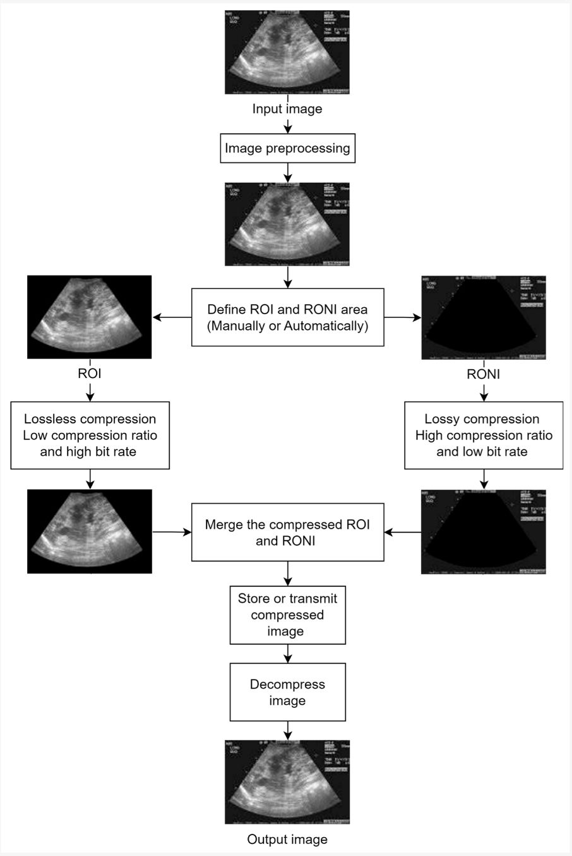

Slide 4
LITERATURE REVIEW
Method | Domain/Technique | Strengths | Limitations/Gaps
JPEG/JPEG-LS | Spatial, predictive & entropy coding | Simple, lossless compression | Treats all regions equally; ROI not prioritized
Block-based PCA | Statistical feature reduction | Reduces redundancy in local blocks | Ignores spatial–frequency variations; ROI edges blurred
JPEG 2000 (Wavelet ROI Coding) | Wavelet transform with Maxshift ROI | Multiresolution, better ROI preservation | Mixed blocks cause ROI boundary distortion
Proposed Method (Rectangular Partition + Wavelet/ Inverse Wavelet) | Hybrid spatial–frequency approach | ROI enhanced, Non-ROI blurred; mixed regions refined | More computation, but highest diagnostic fidelity

Slide 5
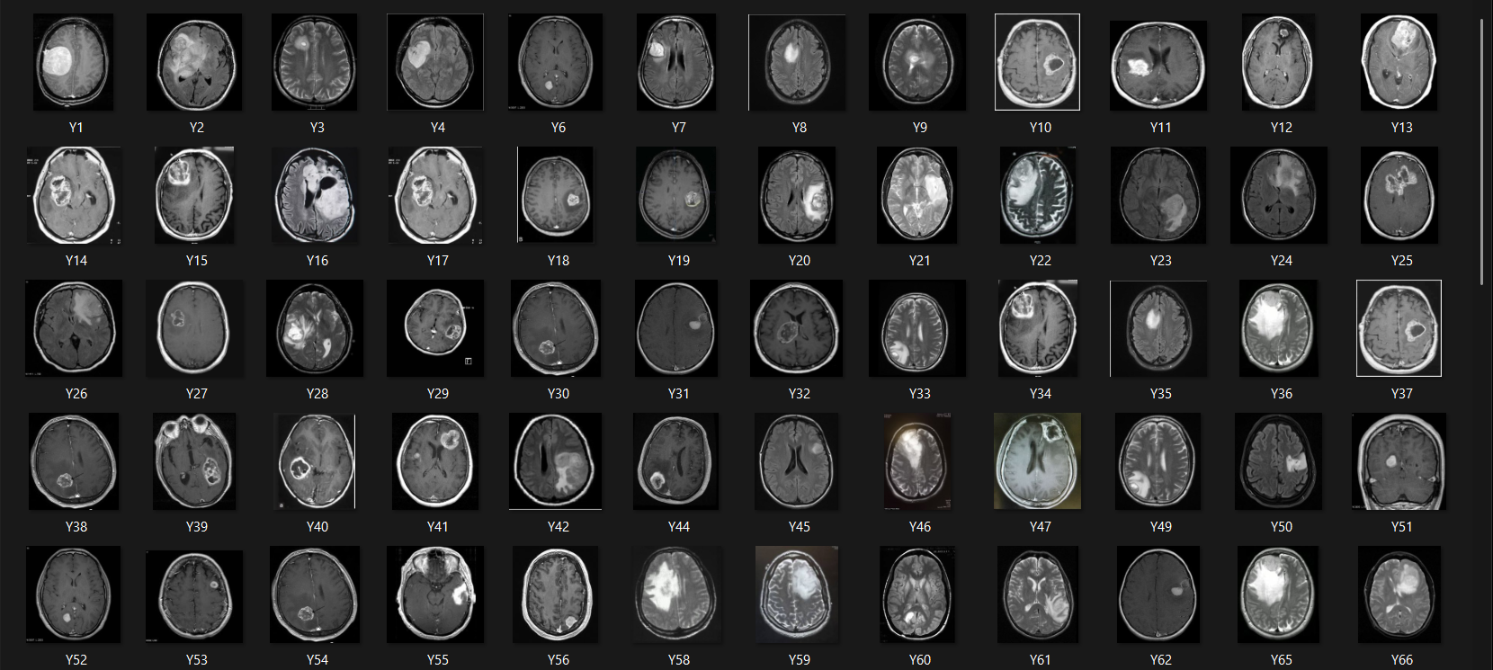
DATASET
It consists of images of brains with tumors.

Slide 6
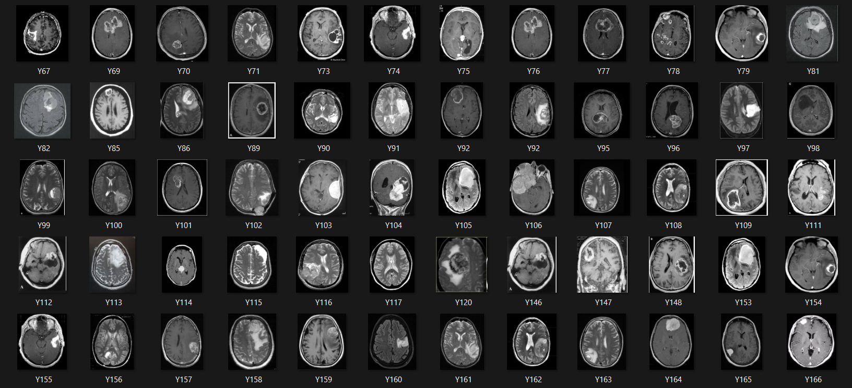
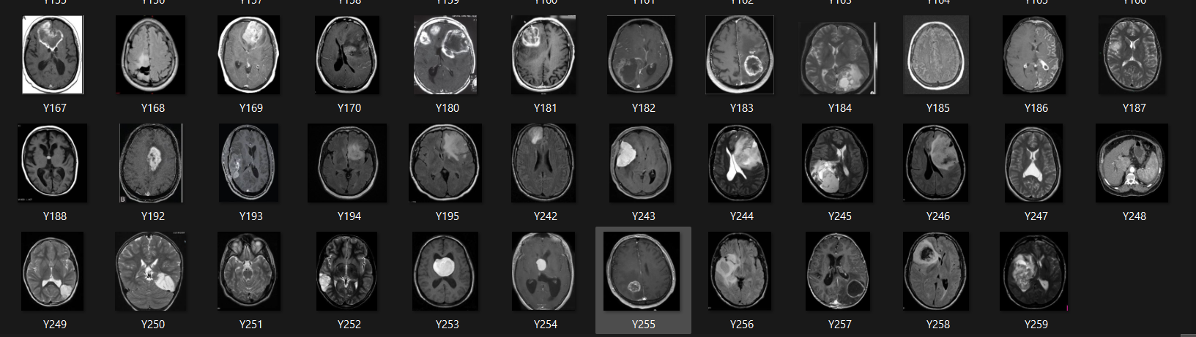

Slide 7
METHODOLOGY
ROI Detection (Tumor Isolation)
Uniform Partitioning
Block Classification and Compact Encoding
Pure ROI Blocks (Green blocks): Apply Sharpening
Pure RONI Blocks (Blue blocks): Apply Aggressive Lossy Compression
Mixed/Boundary Blocks (Red block): Apply Wavelet-like Enhancement

Slide 8
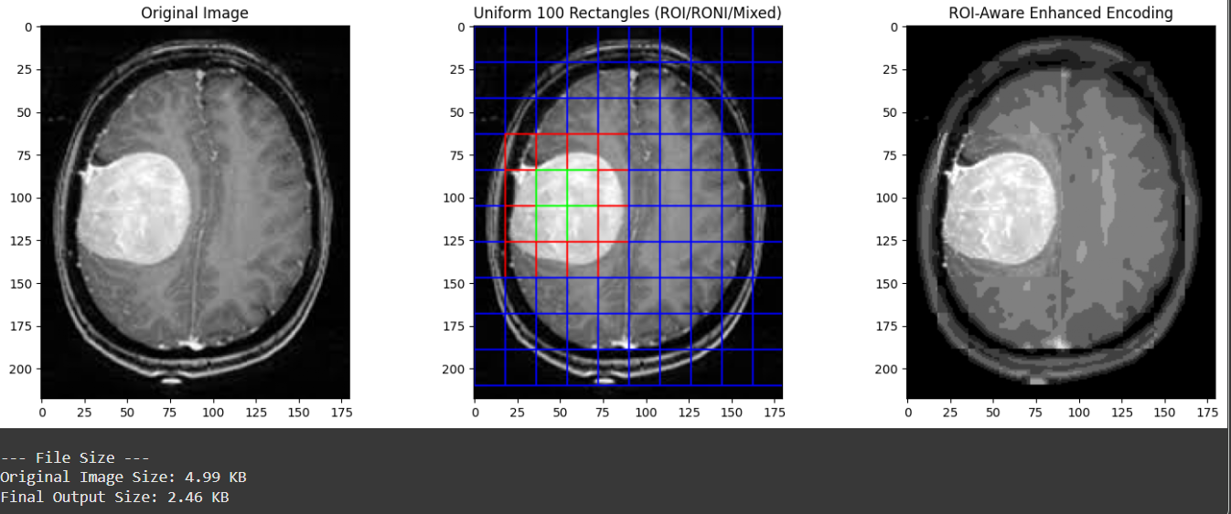
RESULTS

Slide 9
CONCLUSIONS
It uses an ROI-based wavelet transform for efficient image compression.
ROI areas are enhanced, Non-ROI blurred, and Mixed blocks use wavelet and inverse wavelet transforms.
It ensures high quality in key regions and is especially useful in medical imaging to preserve diagnostic details.

Slide 10
NEXT SET OF WORK
Optimize Quadtree: adaptive splitting till ROI purity/min size.
Segmentation-Guided Partitioning: use ROI boxes + grid for rest.
Hybrid Evaluation: compare both methods (mixed blocks, time, quality).
Adaptive Threshold: tune based on scene complexity.
Implementation Plan: prototype → integrate → evaluate.

Slide 11
REFERENCES
Ungureanu, V.-I., Negirla, P., & Korodi, A. (2024). *Image-compression techniques: Classical and “region-of-interest-based” approaches presented in recent papers*. *Sensors, 24*(3), 791. [https://doi.org/10.3390/s24030791](https://doi.org/10.3390/s24030791)
Kafashan, M., Hosseini, H., Beygiharchegani, S., Pad, P., & Marvasti, F. (2010, October). New rectangular partitioning methods for lossless binary image compression. In 2010 IEEE 10th International Conference on Signal Processing (ICSP). IEEE. https://doi.org/10.1109/ICOSP.2010.5655736
Bairagi, V., & Sapkal, A. M. (2013). ROI-based DICOM image compression for telemedicine. Indian Academy of Sciences, 38(1), 123–131. https://www.ias.ac.in/public/Volumes/sadh/038/01/0123-0131.pdf
Dataset-https://www.kaggle.com/navoneel/brain-mri-images-for-brain-tumor-detection
Kiran, R., & Kamargaonkar, C. (2016, March). Region based medical image compression using block-based PCA. In 2016 International Conference on Computation of Power, Energy, Information and Communication (ICCPEIC). IEEE. https://doi.org/10.1109/ICCPEIC.2016.7557289

